Slide 1

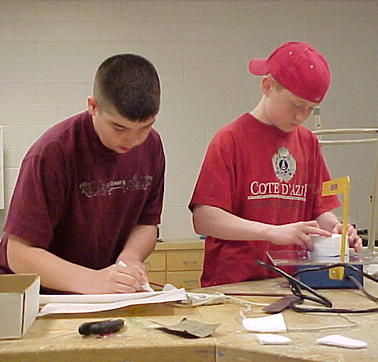
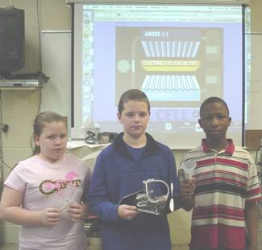




Advanced Design Applications
Manufacturing
Teacher Resource Unit / Lesson Learning Cycle One
Learning Cycle Two – As Good as it Gets
© 2014 International Technology and Engineering Educators Association,
STEMCenter for Teaching and Learning™
Advanced Design Applications
Notes:
© International Technology Education Assoc
Slide #<number>
TITLE SLIDE
12/01/2009
STEMCenter for Teaching & Learning™ Engineering byDesign™

Slide 2

The BIG Idea
Big Idea:
In this learning cycle, students explore factors that affect the quality control in manufacturing processes. Knowledge of how manufacturing is shaped by these external factors will be essential for student success in the Manufacturing Unit Learning Cycles, Preliminary and Primary Challenges of the Advanced Design Applications course.
© 2014 International Technology and Engineering Educators Association
STEMCenter for Teaching and Learning™
Advanced Design Applications
Notes:
[Authors: Please include teacher notes appropriately.]
© International Technology Education Assoc
Slide #<number>
12/01/2009
STEMCenter for Teaching & Learning™ Engineering byDesign™

Slide 3
Objectives
After completing this learning cycle you will be able to:
  Identify how people, materials, tools, and training affect product quality.
  Explain how quality control is affected by input and output factors when applied to a manufacturing process.
© 2014 International Technology and Engineering Educators Association
STEMCenter for Teaching and Learning™
Advanced Design Applications
Notes:
[Authors: Please include teacher notes appropriately.]
© International Technology Education Assoc
Slide #<number>
12/01/2009
STEMCenter for Teaching & Learning™ Engineering byDesign™

Slide 4
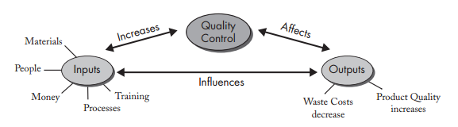
Factors Affecting Quality Control
Cost of developing idea
Cost to produce
Quality of finished product
Packaging and shipping costs
www.clipartbest.com
© 2014 International Technology and Engineering Educators Association
STEMCenter for Teaching and Learning™
Advanced Design Applications
Notes:
Internal factors are largely influenced by the design or development team and are driven by cost and quality control. These factors include expenses associated with the product ideation (i.e., the cost of developing the idea), how much it will cost to manufacture the product (keeping in mind the materials, processes, and labor), the quality of the finished product, and the packaging and shipping costs.
© International Technology Education Assoc
Slide #<number>
12/01/2009
STEMCenter for Teaching & Learning™ Engineering byDesign™

Slide 5
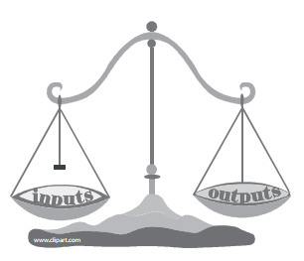
Inputs and Outputs
  Input Factors
    Money
    People
    Materials
    Tools
    Training
    Output Factors
      Quality vs. Cost
© 2014 International Technology and Engineering Educators Association
STEMCenter for Teaching and Learning™
Advanced Design Applications
Notes:
Quality control in manufacturing is maintained through two different kinds of factors. There are input and output factors. Input factors include money, people, materials, tools, and training. Output factors include the quality of a product verses how much it costs to make that product. Quality control involves trying to achieve a balance between the input and output factors. Spending more money on materials, tools, and training will more than likely increase the quality of the product while reducing the cost of waste. On the other hand, spending less money on input factors will also decrease the quality of the product while waste costs (and probably short-term profits) will increase. The development team within any manufacturing enterprise must make trade-offs as it designs new products or modifies existing ones.
© International Technology Education Assoc
Slide #<number>
12/01/2009
STEMCenter for Teaching & Learning™ Engineering byDesign™

Slide 6

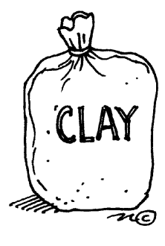

Designing for Quality
  Metallic
  Ceramic
  Polymeric
  Combined to create composites
  Casting and Molding
  Separating
  Forming
  Fabricating
  Conditioning
  Finishing
http://www.clker.com/clipart-25741.html
http://school.discoveryeducation.com/clipart/clip/claybag.html
© 2014 International Technology and Engineering Educators Association
STEMCenter for Teaching and Learning™
Advanced Design Applications
http://www.gograph.com/stock-illustration/raw-materials.html
Notes:
There are a number of materials and processes to consider when manufacturing a product. As discussed in the Preliminary Challenge, most materials fall into one of three categories: metallic, ceramic, and polymeric. Materials from these three categories can be combined to create a composite material. Processes are likewise divided into categories. They are generally categorized into six processes: casting and molding, separating, forming, fabricating, conditioning, and finishing.
© International Technology Education Assoc
Slide #<number>
12/01/2009
STEMCenter for Teaching & Learning™ Engineering byDesign™

Slide 7

Designing for Quality
Material and Processing affect quality
Quality considered from beginning
Consider effects of materials and processes decisions
Trade off decisions made
© 2014 International Technology and Engineering Educators Association
STEMCenter for Teaching and Learning™
Advanced Design Applications
Notes:
The choice of the material and the way it is processed will affect the quality of the product. Thus, quality is considered from the beginning stage of design and production. Designers must consider the effect a given material or process may have on quality and their target customer. Trade-off decisions are often made to accommodate the use of one material for higher quality. Sometimes quality is sacrificed a bit for a more affordable way to process the material.
© International Technology Education Assoc
Slide #<number>
12/01/2009
STEMCenter for Teaching & Learning™ Engineering byDesign™

Slide 8

Normally-closed sensors
  Closed when not activated (turned on)
  Open when activated (turned off)
Normally-open sensors
  Open when not activated (turned off)
  Closed when activated (turned on)
  Depending on the type of device or sensor, the program may cause the opposite output than expected.
Tennis Racket Heads
Material used greatly impacts quality
  Wooden frame
    Smaller heads
    Warps easily
  Graphite/Titanium
    Stronger frame
    Longer life
http://www.sportsclipart.com/sports_clipart/clip_art_illustration_of_a_tennis_racket_and_tennis_ball_0071-0901-2000-5519.html
© 2014 International Technology and Engineering Educators Association
STEMCenter for Teaching and Learning™
Advanced Design Applications
Notes:
The choice of material used for a tennis racket frame, for example, greatly impacts its quality. The traditional tennis racket was made from a wooden frame. However, because of design limitations (smaller heads required to accommodate the strings) new materials, like graphite and titanium, are now used to make frames. Trade-offs in the design process are made to accommodate quality and cost with the consumer in mind. The “better” the material, the higher quality and often the higher price. Aluminum tennis rackets are inexpensive, but in terms of performance they are lower in quality. Carbon, graphite, and titanium composite tennis rackets are more expensive, but allow for higher quality performance for consumers.
© International Technology Education Assoc
Slide #<number>
12/01/2009
STEMCenter for Teaching & Learning™ Engineering byDesign™

Slide 9
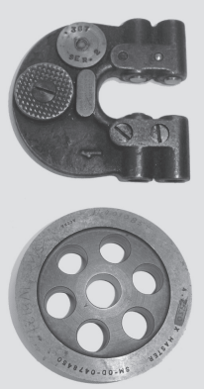
Production Quality Control
Systematic way to check specifications of product
Primary goal to ensure quality of finished product
Gauges most often used
  Product size
  Production volume
  Gauging conditions
© 2014 International Technology and Engineering Educators Association
STEMCenter for Teaching and Learning™
Advanced Design Applications
Notes:
Every manufacturer has a systematic way of checking the production line to make sure that the product is being produced within the desired specifications. Different quality control methods are often used. Some methods include checking every product by hand or checking a random selection for quality. The primary goal no matter what technique is used, is to ensure the quality of the finished product.
Gauges are often used to test the quality of a product. The specific gauge best suited for an application will depend on a variety of factors, including product size, production volume, and gauging conditions. Some production lines use “go/no go” devices to check the quality of the products being manufactured. A “go/no go” gauge is a device that determines whether a product meets the specifications of an acceptable product for the market. If it does, the product is a “go”. If the product fails to meet the specifications as measured by the gauge, it is a “no go”.
© International Technology Education Assoc
Slide #<number>
12/01/2009
STEMCenter for Teaching & Learning™ Engineering byDesign™

